Slide 1
BHAVYA TEXTILES

Slide 2
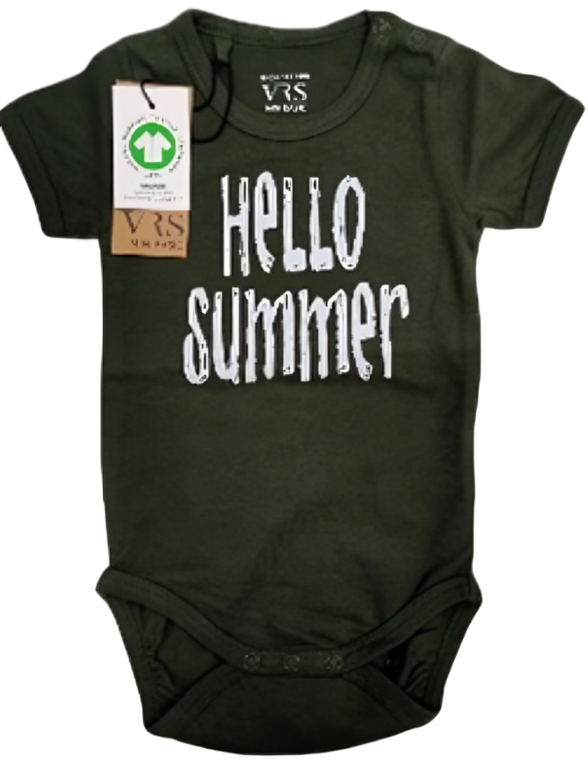
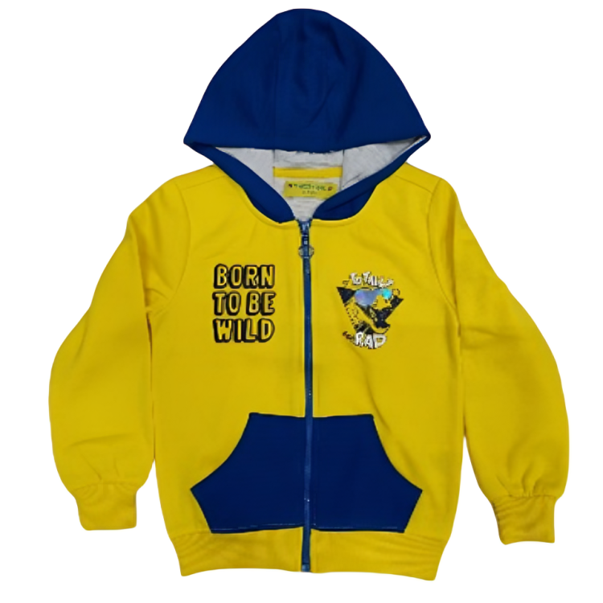
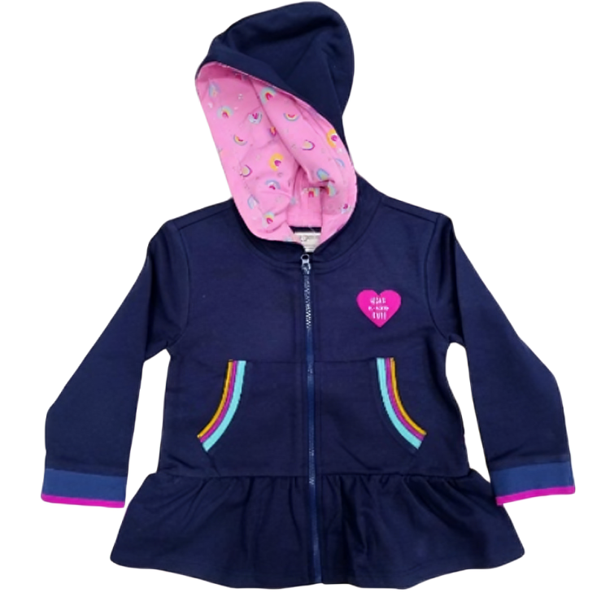
KIDS WEAR

Slide 3
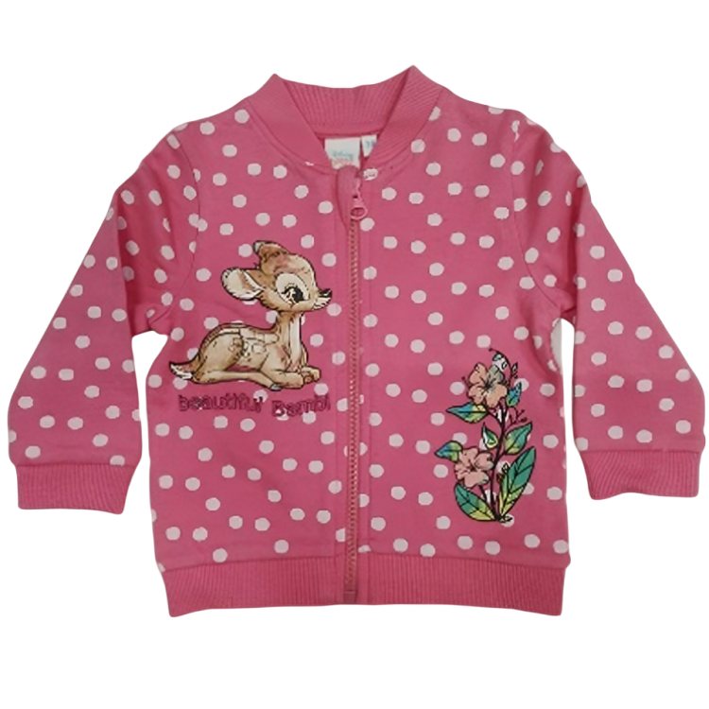
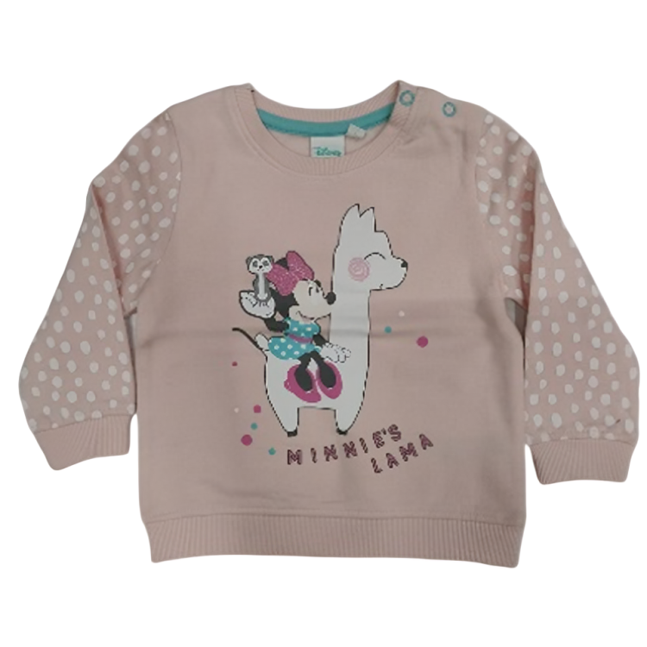
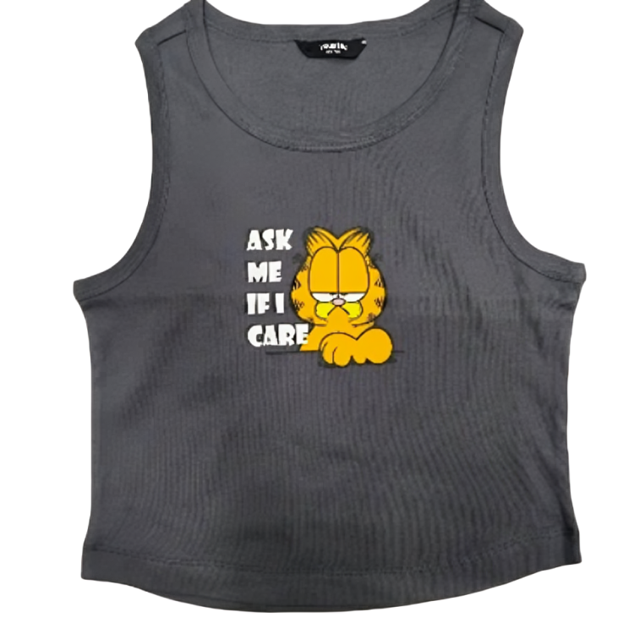
KIDS WEAR

Slide 4
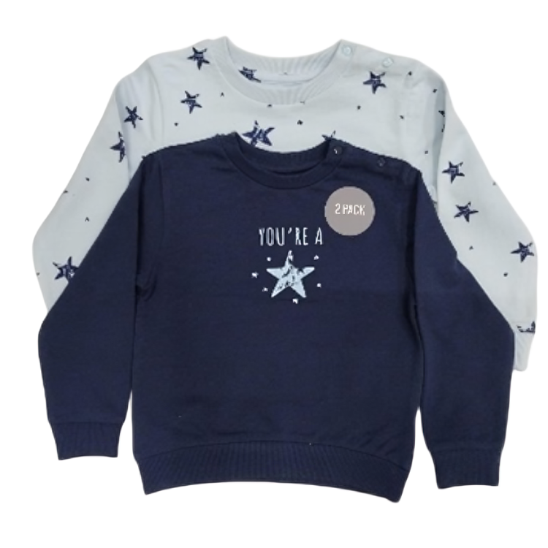
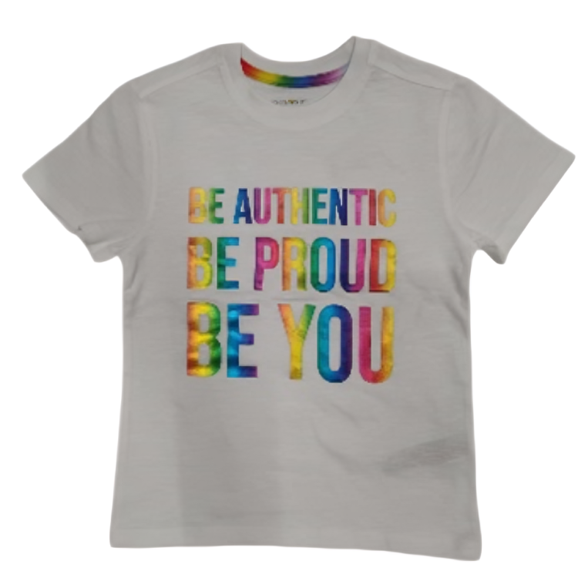
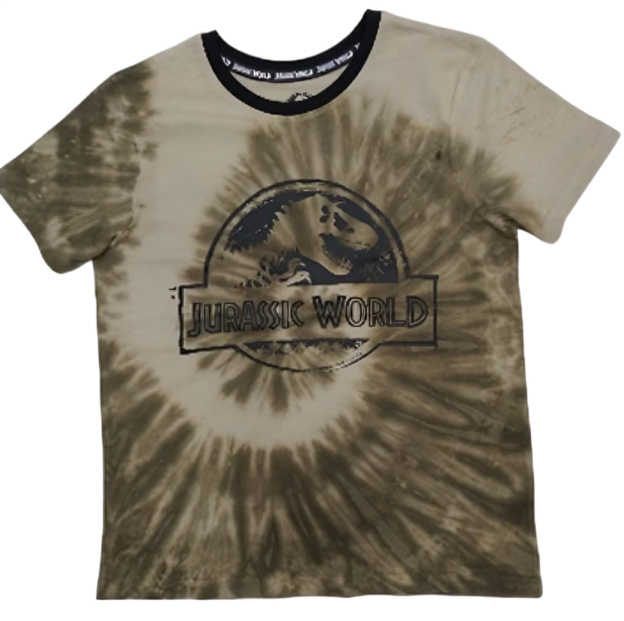
KIDS WEAR

Slide 5
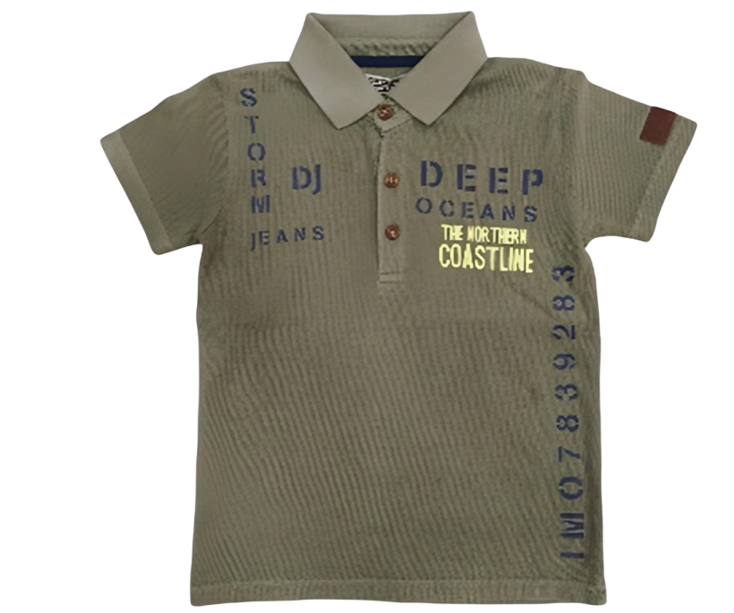
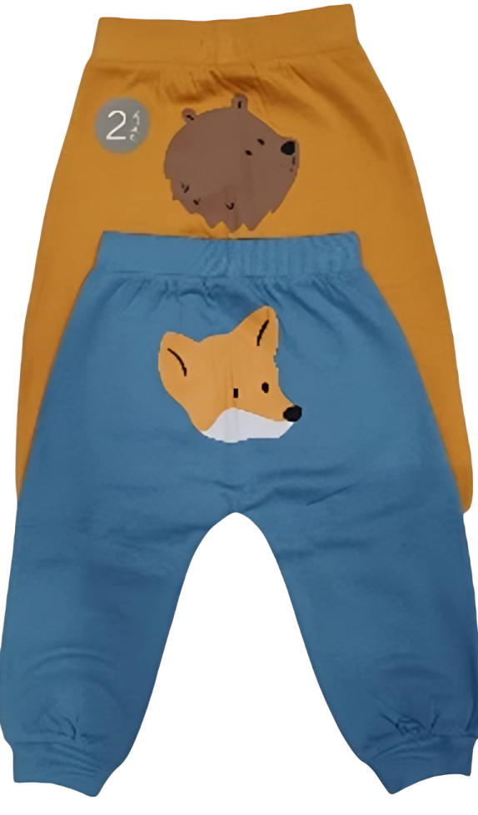
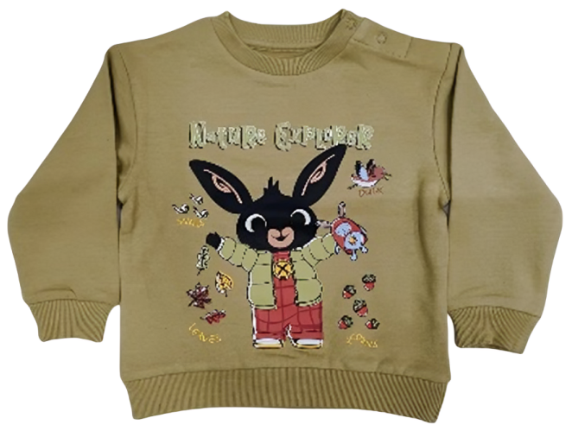
KIDS WEAR

Slide 6
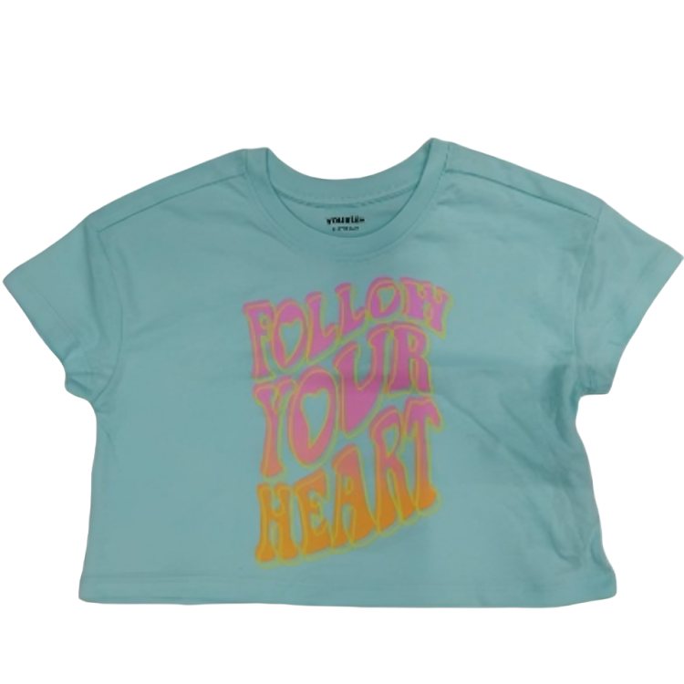
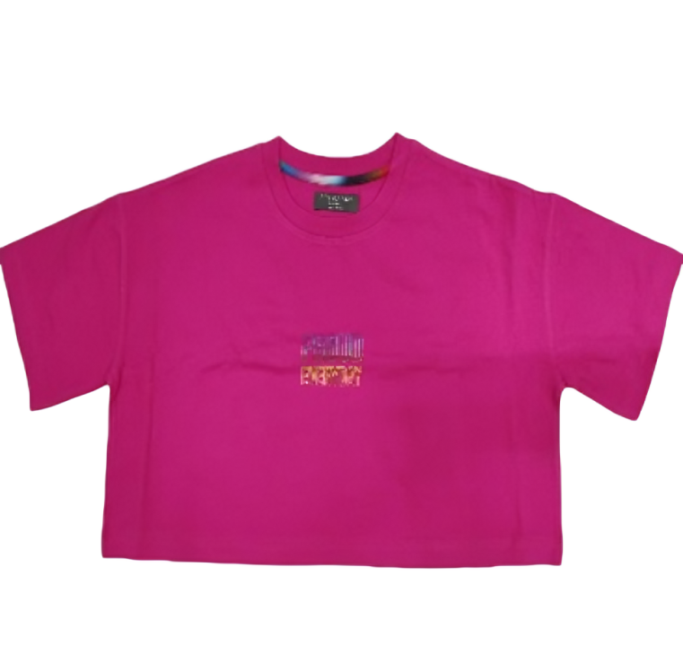
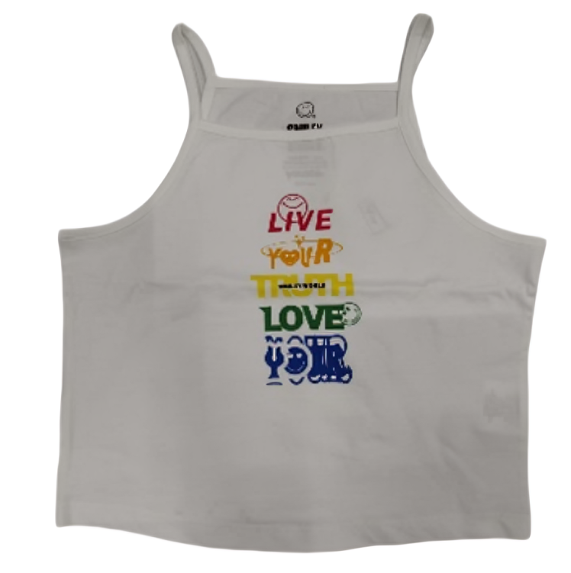
KIDS WEAR

Slide 7
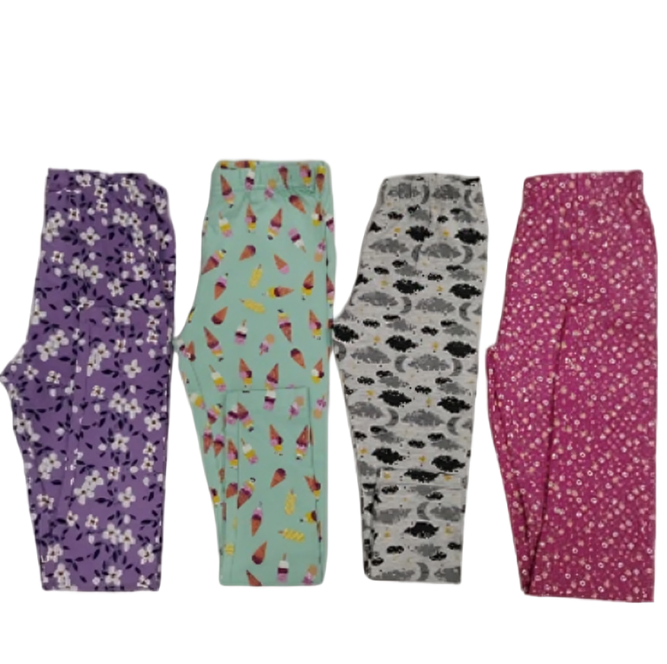
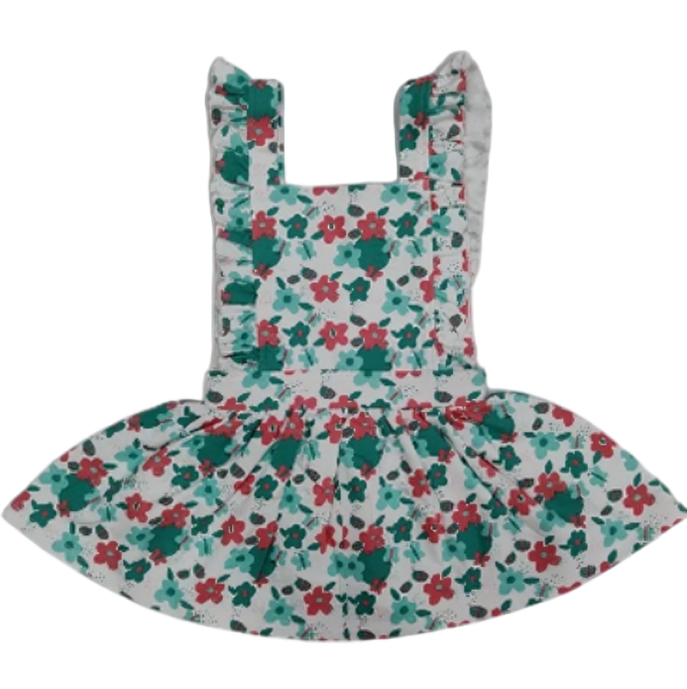
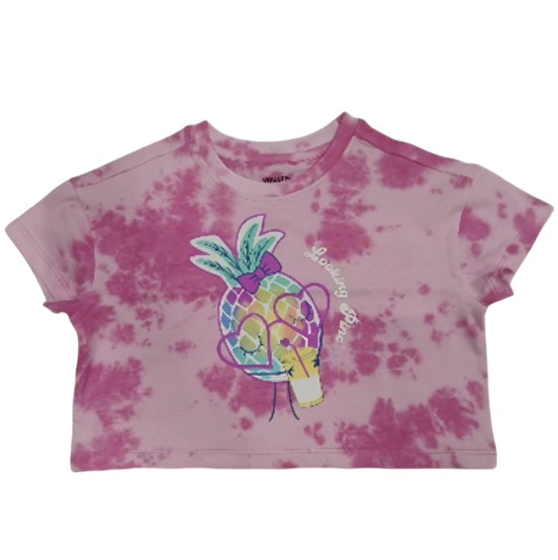
KIDS WEAR

Slide 8
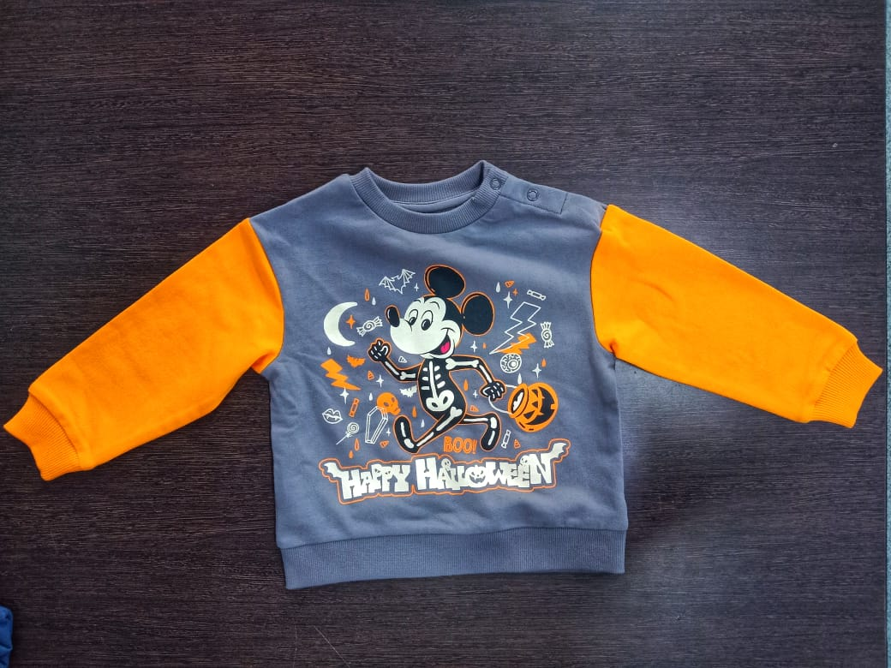
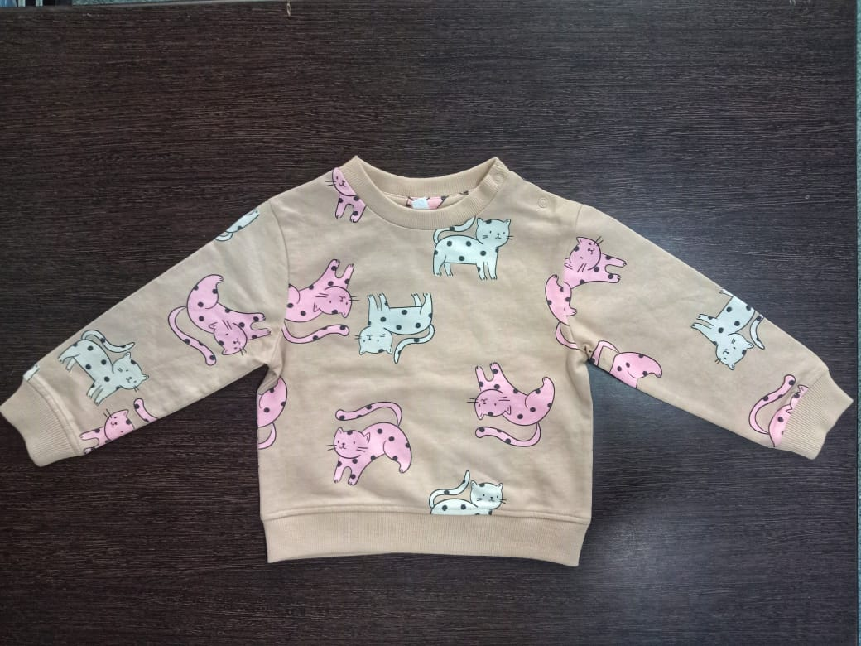
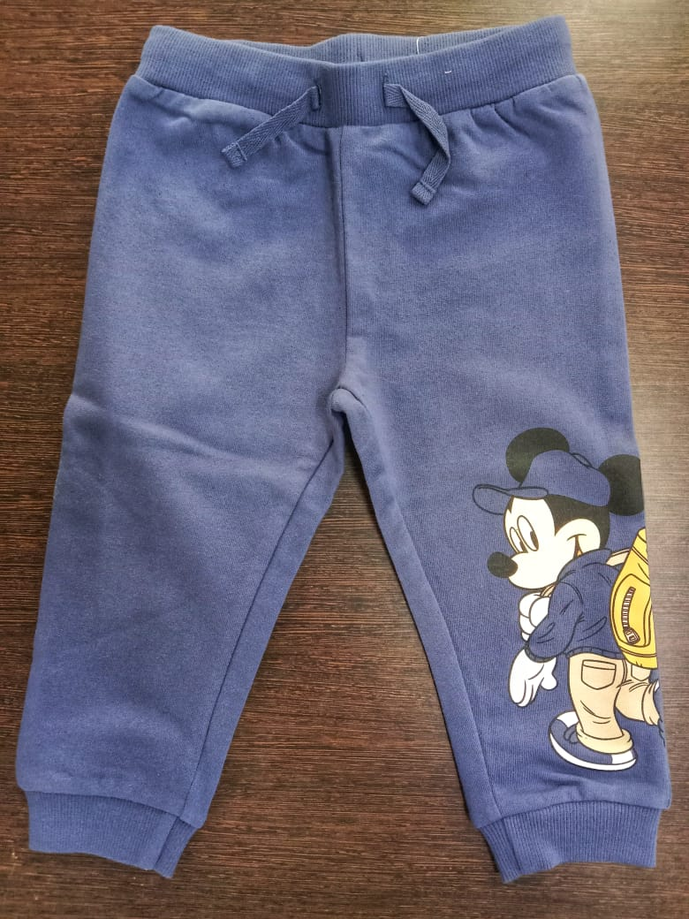
KIDS WEAR

Slide 9
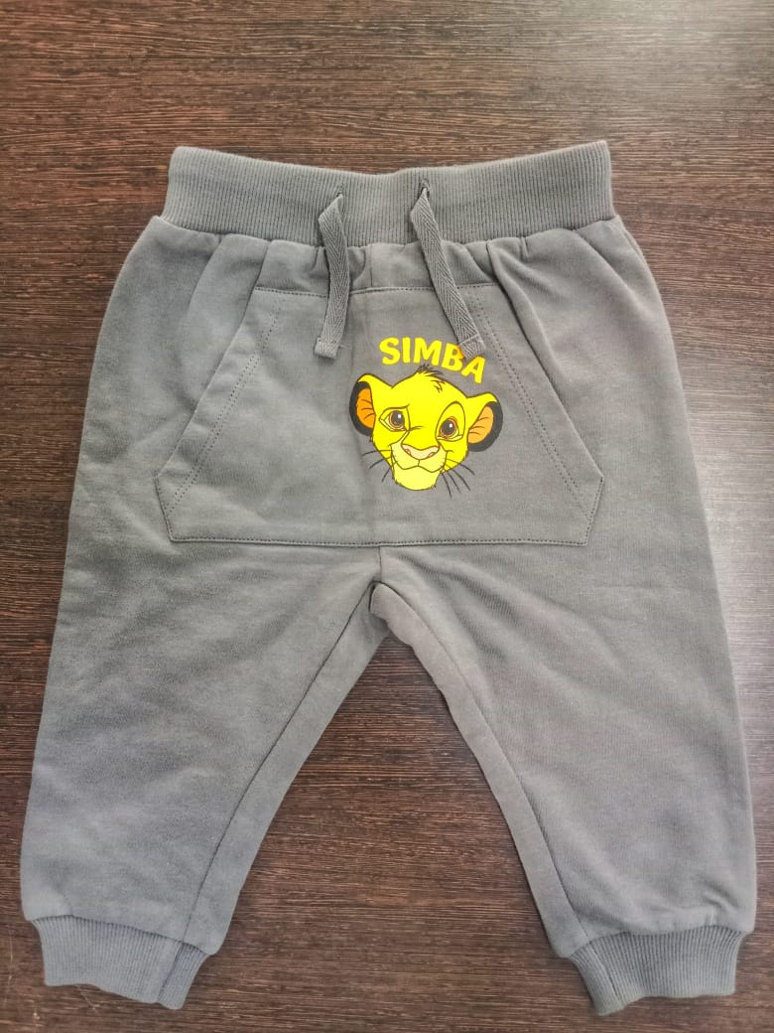
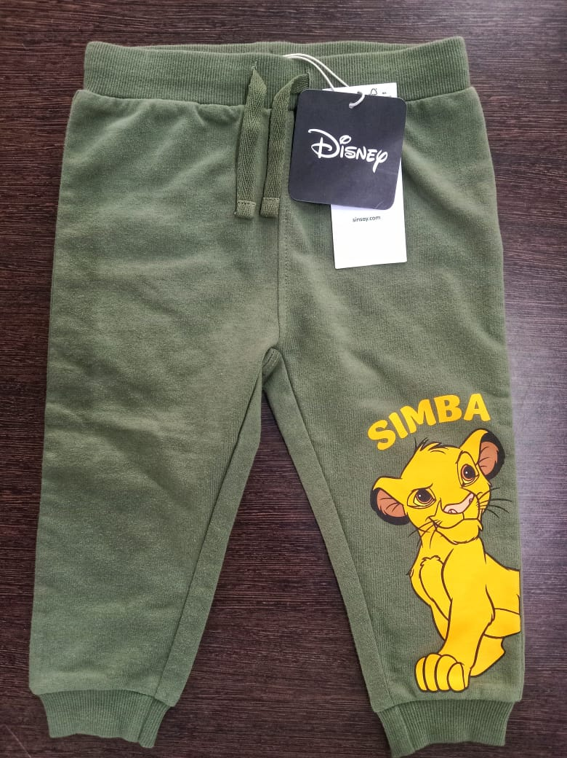
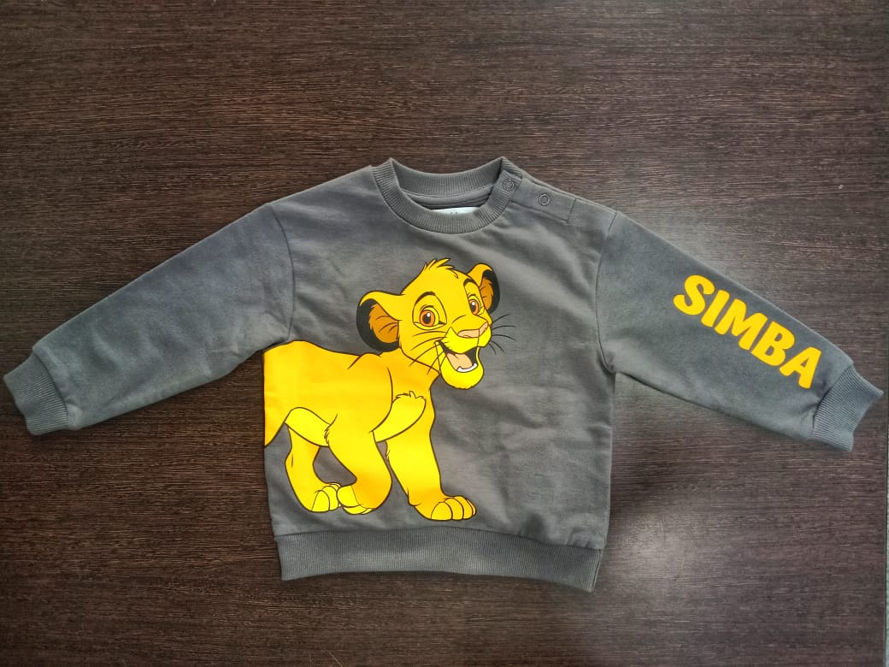
KIDS WEAR

Slide 10
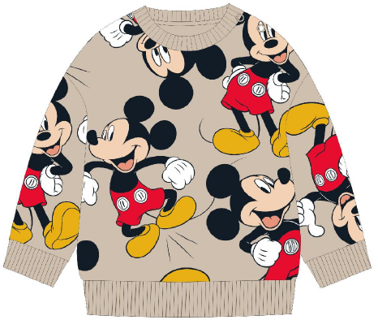
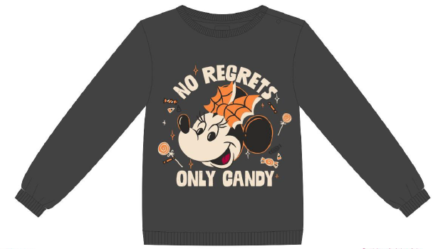
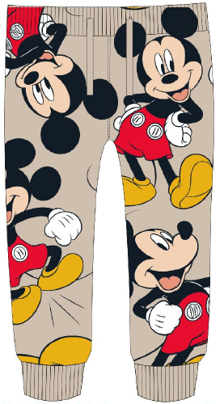
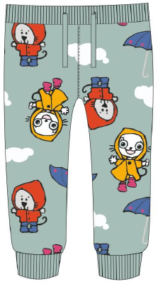
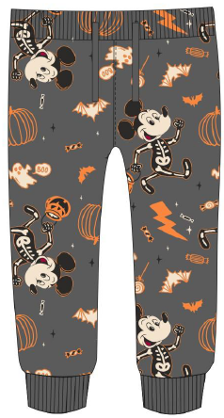
KIDS WEAR

Slide 11
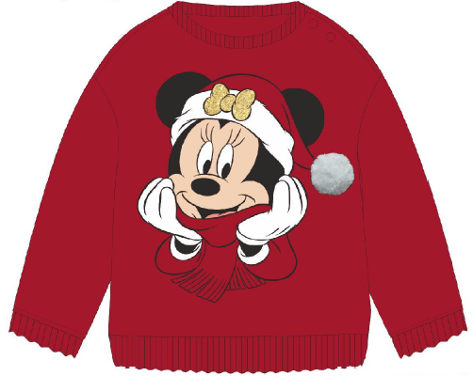
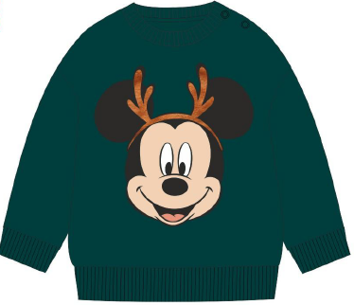
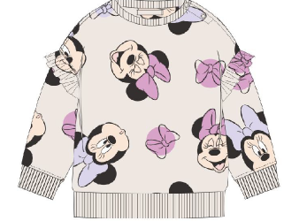
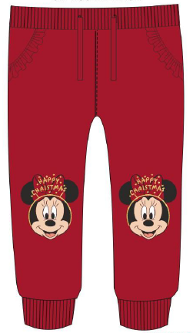
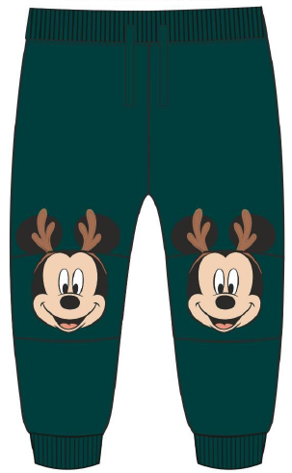
KIDS WEAR

Slide 12
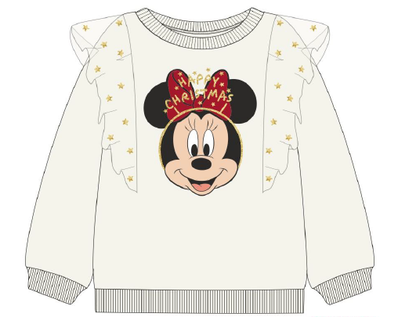
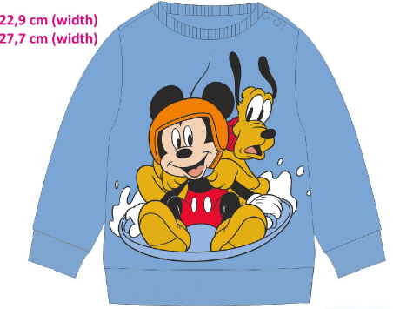
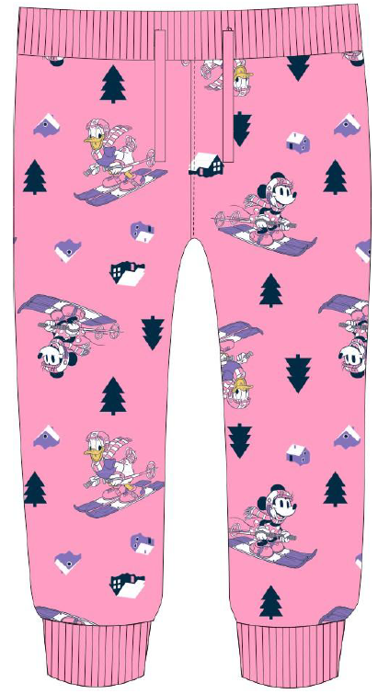
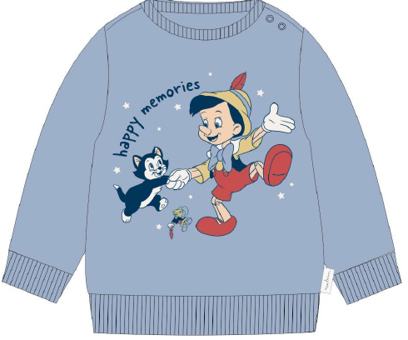

Slide 13
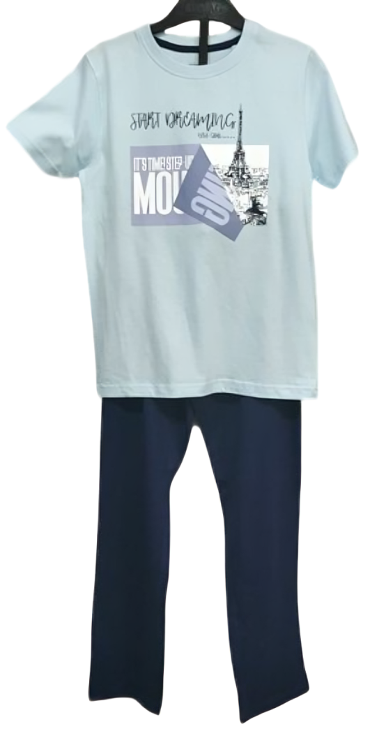
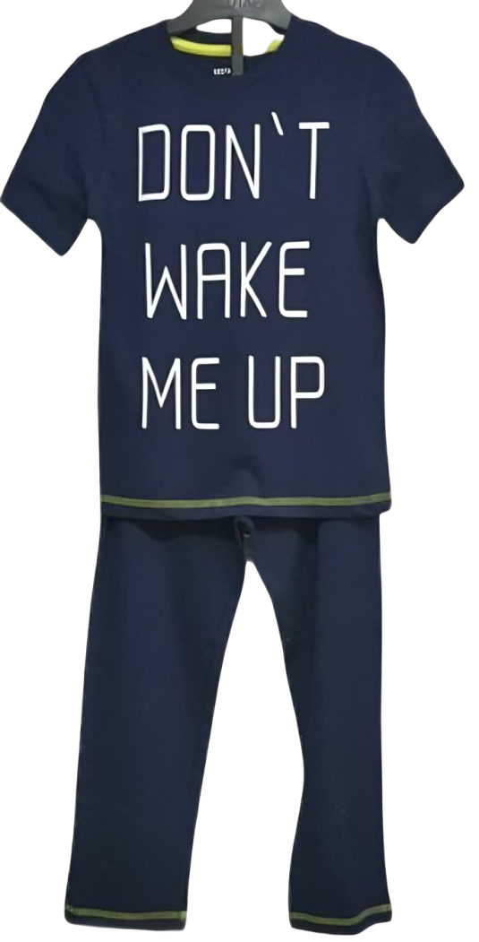
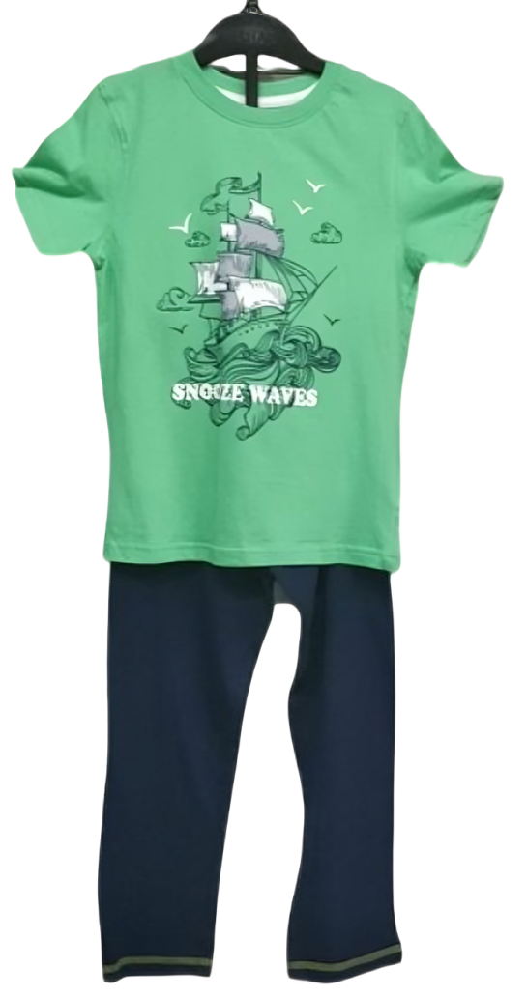
MEN’S NIGHT WEAR SETS

Slide 14
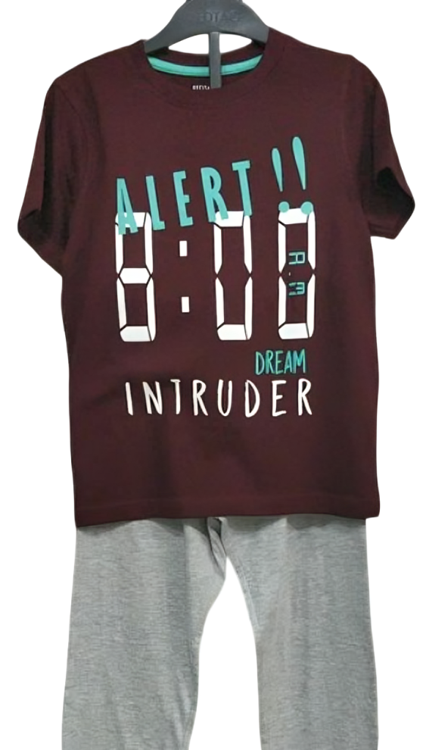
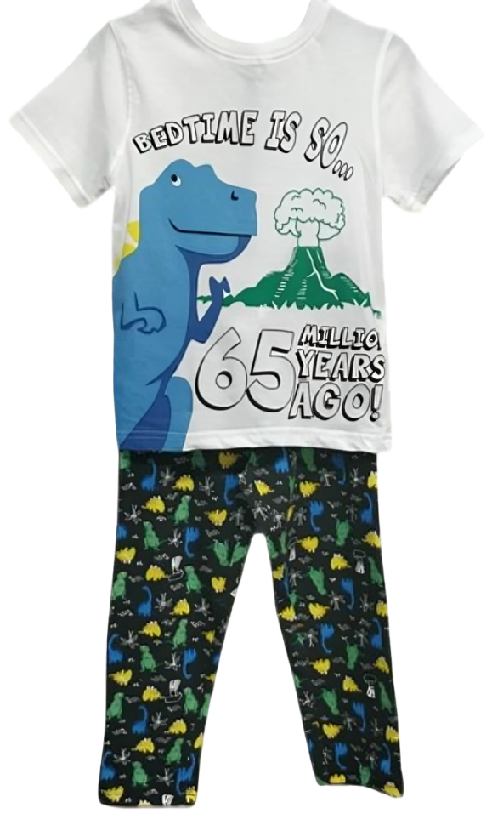
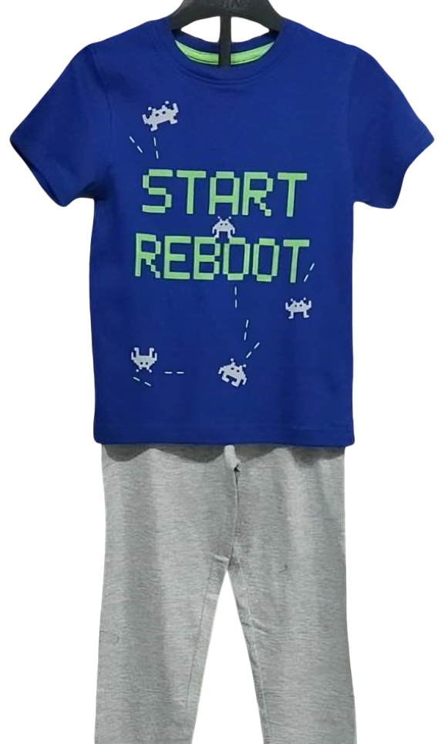
MEN’S NIGHT WEAR SETS

Slide 15
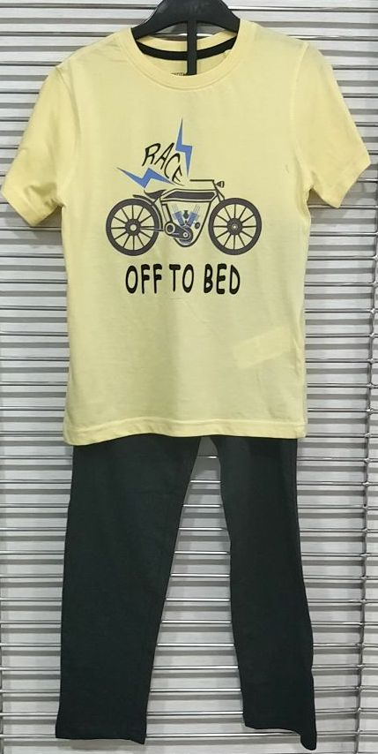
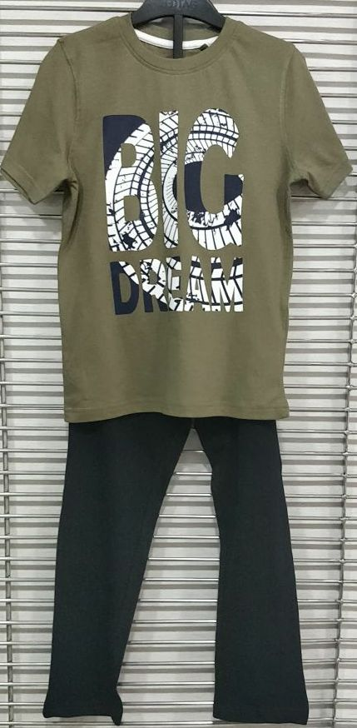
MEN’S NIGHT WEAR SETS

Slide 16
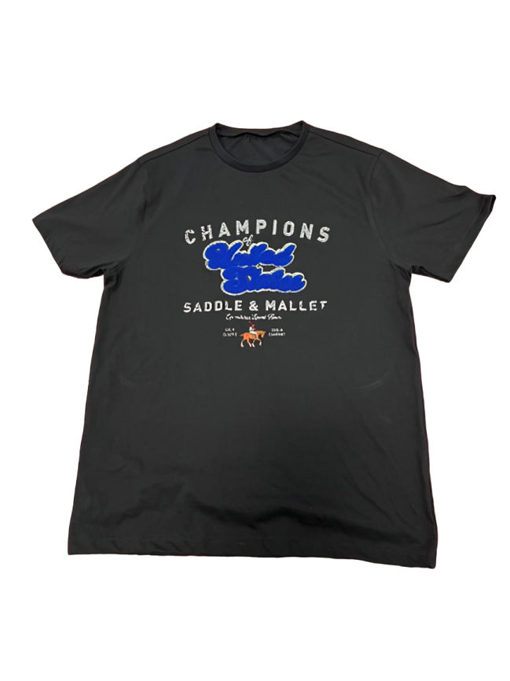
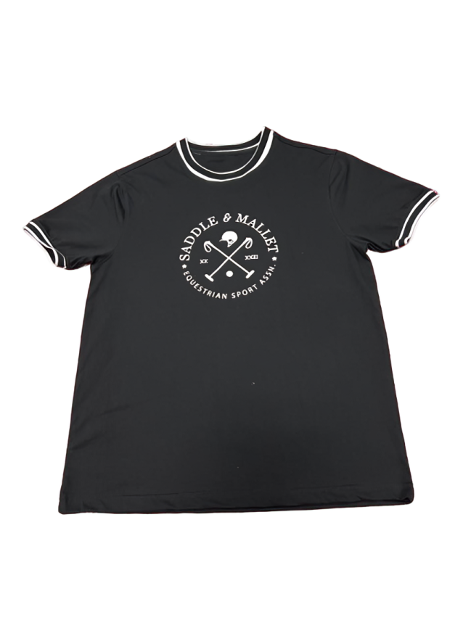
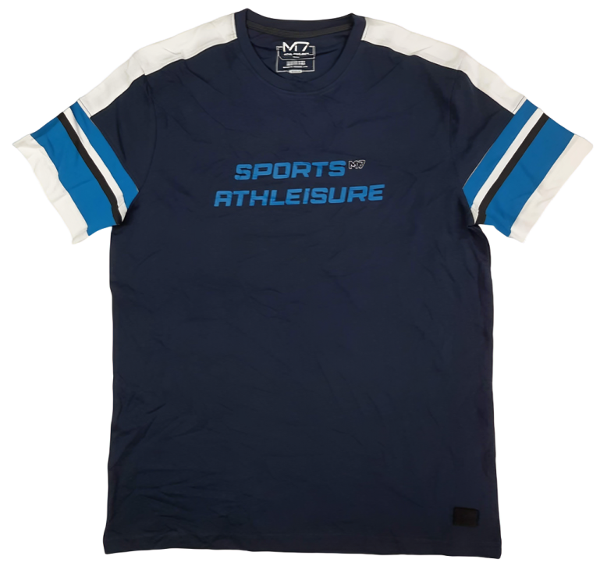
MEN’S Tees

Slide 17
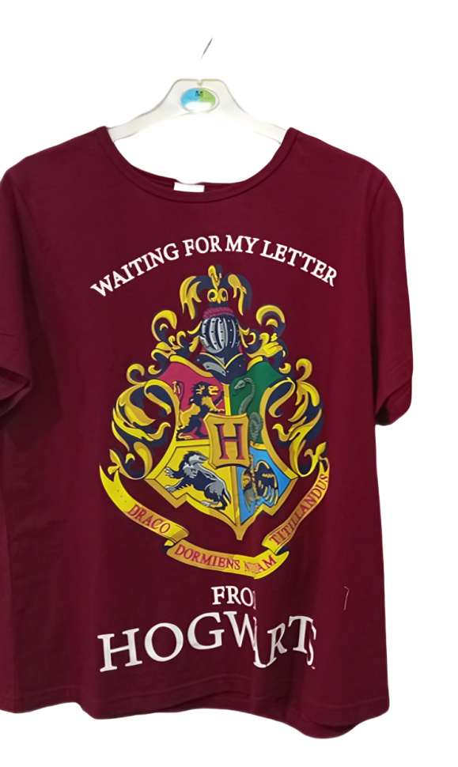


MEN’S Tees

Slide 18



MEN’S Tees

Slide 19



MEN’S Tees

Slide 20



MEN’S Tees

Slide 21



MEN’S Polo

Slide 22



MEN’S Polo

Slide 23



MEN’S Winter Wear

Slide 24



MEN’S Winter Wear

Slide 25


MEN’S Winter Wear

Slide 26



MEN’S Joggers

Slide 27


MEN’S Joggers

Slide 28



MEN’S Shorts

Slide 29



MEN’S Shorts

Slide 30


MEN’S Shorts

Slide 31



WOMEN’S NIGHT WEAR

Slide 32




WOMEN’S NIGHT WEAR

Slide 33



WOMEN’S NIGHT WEAR

Slide 34





WOMEN’S NIGHT WEAR SETS – KNITS & WOVENS

Slide 35






WOMEN’S NIGHT WEAR

Slide 36










WOMEN’S NIGHTWEAR

Slide 37










WOMEN’S NIGHTWEAR

Slide 38







WOMEN’S NIGHTWEAR SETS

Slide 39







WOMEN’S NIGHTWEAR

Slide 40







WOMEN’S NIGHTWEAR

Slide 41








WOMEN’S NIGHTWEAR

Slide 42




WOMEN’S NIGHT WEAR – KNITS & WOVENS

Slide 43




WOMEN’S NIGHT WEAR – KNITS & WOVENS

Slide 44



WOMEN’S NIGHT WEAR – KNITS & WOVENS

Slide 45




WOMEN’S NIGHT WEAR – KNITS & WOVENS

Slide 46



WOMEN’S NIGHT WEAR

Slide 47




WOMEN’S NIGHT WEAR

Slide 48




WOMEN’S NIGHT WEAR

Slide 49



WOMEN’S NIGHT WEAR

Slide 50



WOMEN’S JACKET/ TOP

Slide 51




WOMEN’S TEES

Slide 52




WOMEN’S TEES

Slide 53




WOMEN’S NIGHT WEAR – KNITS & WOVENS

Slide 54





WOMEN’S NIGHT SHORTS – KNITS & WOVENS

Slide 55



WOMEN’S NIGHT WEAR SETS – KNITS & WOVENS

Slide 56




WOMEN’S NIGHT WEAR

Slide 57








WOMEN’S Tee

Slide 58




WOMEN’S TEES

Slide 59




WOMEN’S DRESS

Slide 60




WOMEN’S DRESS

Slide 61




Slide 62



WOMEN’S DRESS

Slide 63



WOMEN’S TEES

